Slide 1
DATABASE TECH – INTAIA23DT001
Team : DATA DETECTIVES
TERADATA TO SNOWFLAKE
MIGRATION
Data Migration from Teradata to Snowflake Using AWS S3
By SUBARNA PAUL (2273785)
Mentor : KAVIN KUMAR GOVINDARAJ (768921​)

Slide 2





CONTENT
Analysis &
Requirement Gathering
Design & Approval ​
Implementation & Coding
Testing & Validation
Conclusion

Slide 3



ANALYSIS & REQUIREMENT GATHERING
-TERADATA, AWS & SNOWFLAKE OVERVIEW
Teradata is one of the popular Relational Database Management System. It is mainly suitable for building large scale data warehousing applications. Teradata achieves this by the concept of parallelism. It is developed by the company called Teradata on the year 1979.
Amazon Web Services (AWS) is a cloud computing platform that offers a wide range of cloud services including compute power, storage, databases, networking, analytics , ML etc.
Snowflake is a fully managed SaaS (software as a service) that provides a single platform for data warehousing, data lakes, data engineering, data science, data application development, and secure sharing and consumption of real-time / shared data.

Slide 4
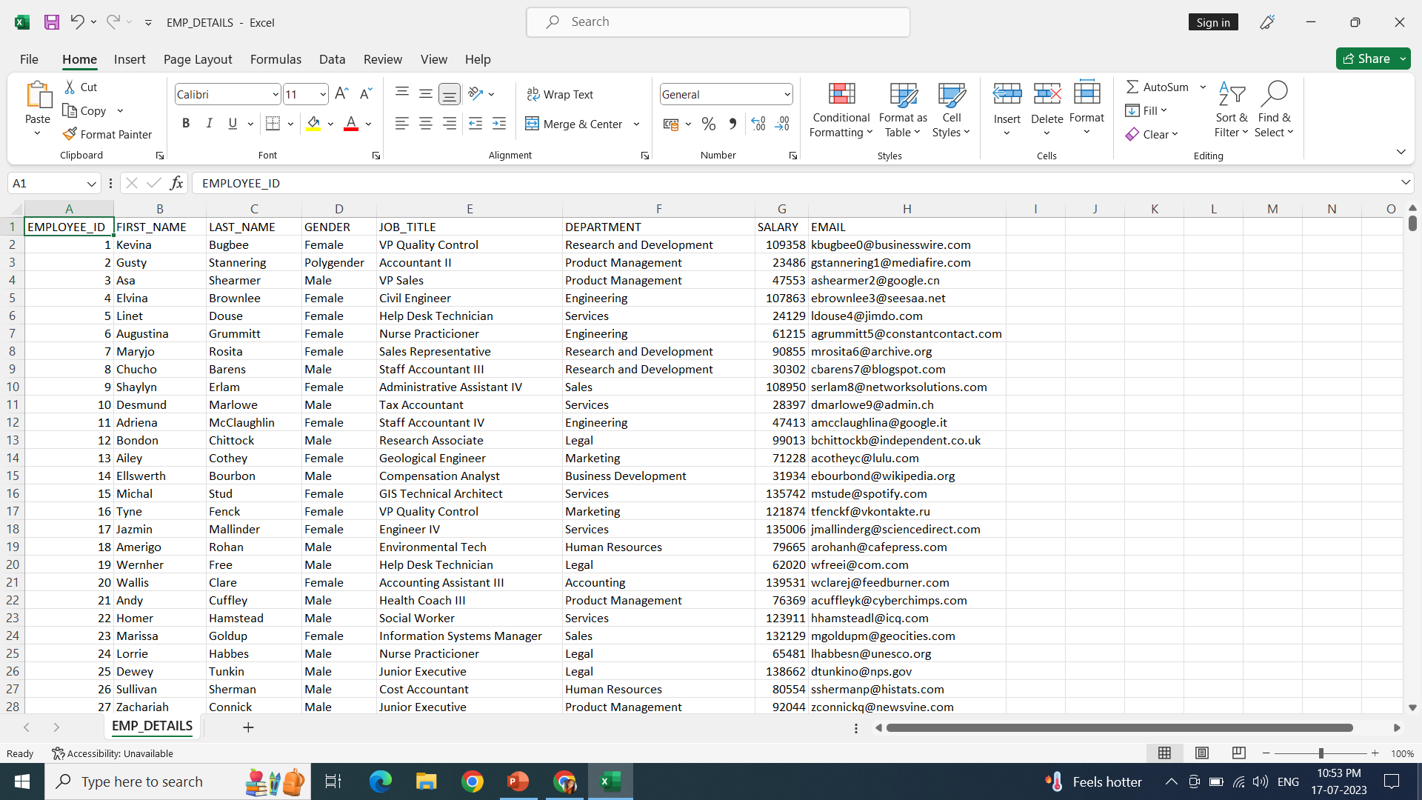

ANALYSIS & REQUIREMENT GATHERING
- SOURCE FILE
We are taking CSV (Comma separated value) which contains 1000 Employee details for data migration.

Slide 5

ANALYSIS & REQUIREMENT GATHERING
- REQUIREMENTS
Teradata setup : We must have proper Teradata setup.
AWS Account : Must have valid AWS Account.
AWS IAM Role setup : We must create proper IAM role for connection.
Snowflake Account : Must have valid Snowflake Account.
File Format : Use proper file format(CSV).
Snowflake storage integration : Connection between other cloud platforms and Snowflake.
Snowflake stage : Create a stage for data loading.
Snowflake Integration By Data Loading Command : Utilize the snowflake's COPY INTO statement.
Data Validation : Verify the loaded data to ensure desired visualization.

Slide 6
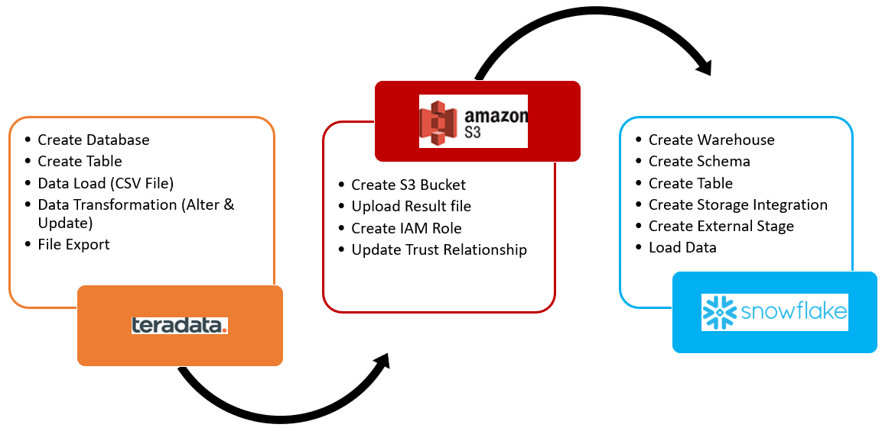
DESIGN & APPROVAL ​
- DATA MIGRATION METHOD
We are migrating the data from Teradata to Snowflake using AWS S3 as an intermediate data storage layer and performing ETL operations in between.

Slide 7
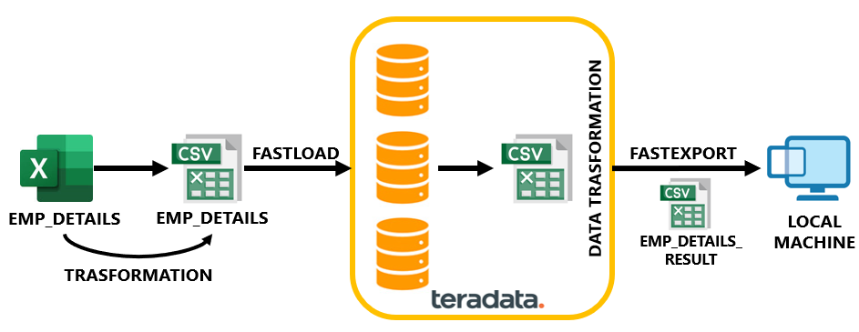
DESIGN & APPROVAL ​
- WORKFLOW PHASE 1

Slide 8
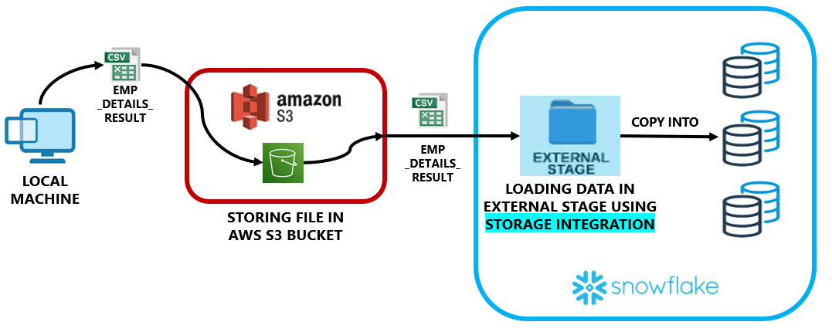
DESIGN & APPROVAL ​
- WORKFLOW PHASE 2

Slide 9
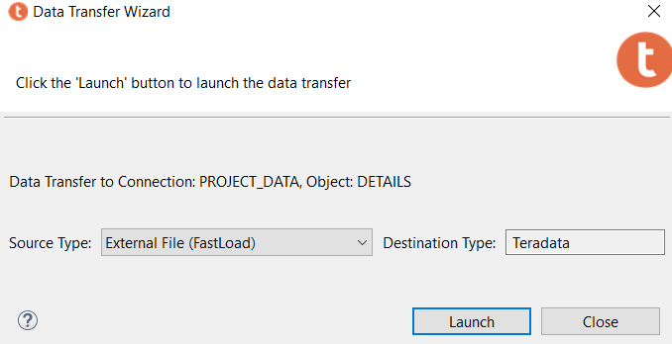
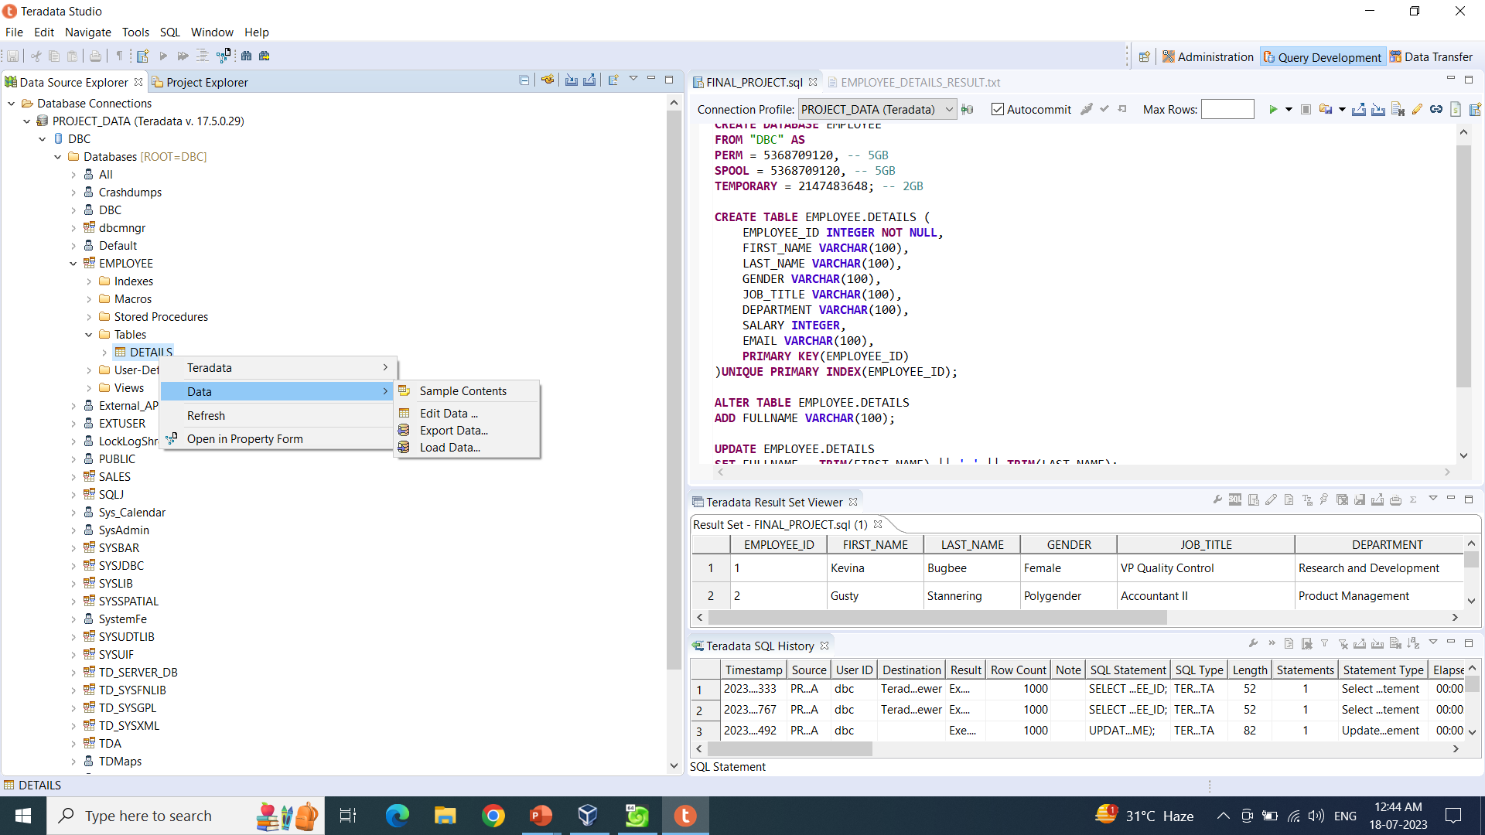
IMPLEMENTATION & CODING ​
- FAST LOAD : TERADATA
We select Load Data in the Data drop down section to Load the data in the DETAILS table in Teradata using FAST LOAD.
Fast Load Successful

Slide 10
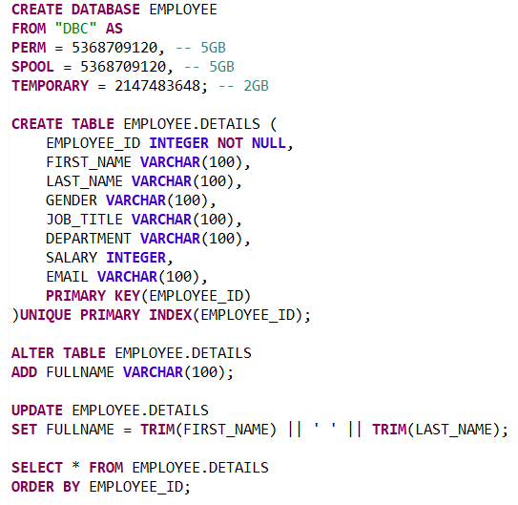
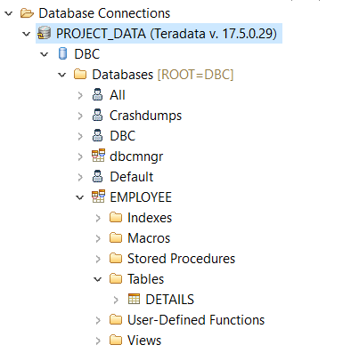
IMPLEMENTATION & CODING ​
- CODING : TERADATA
EMPLOYEE Database
is created
DETAILS Table
is created under
EMPLOYEE Database
Data
Transformation
Teradata Object Hierarchy

Slide 11
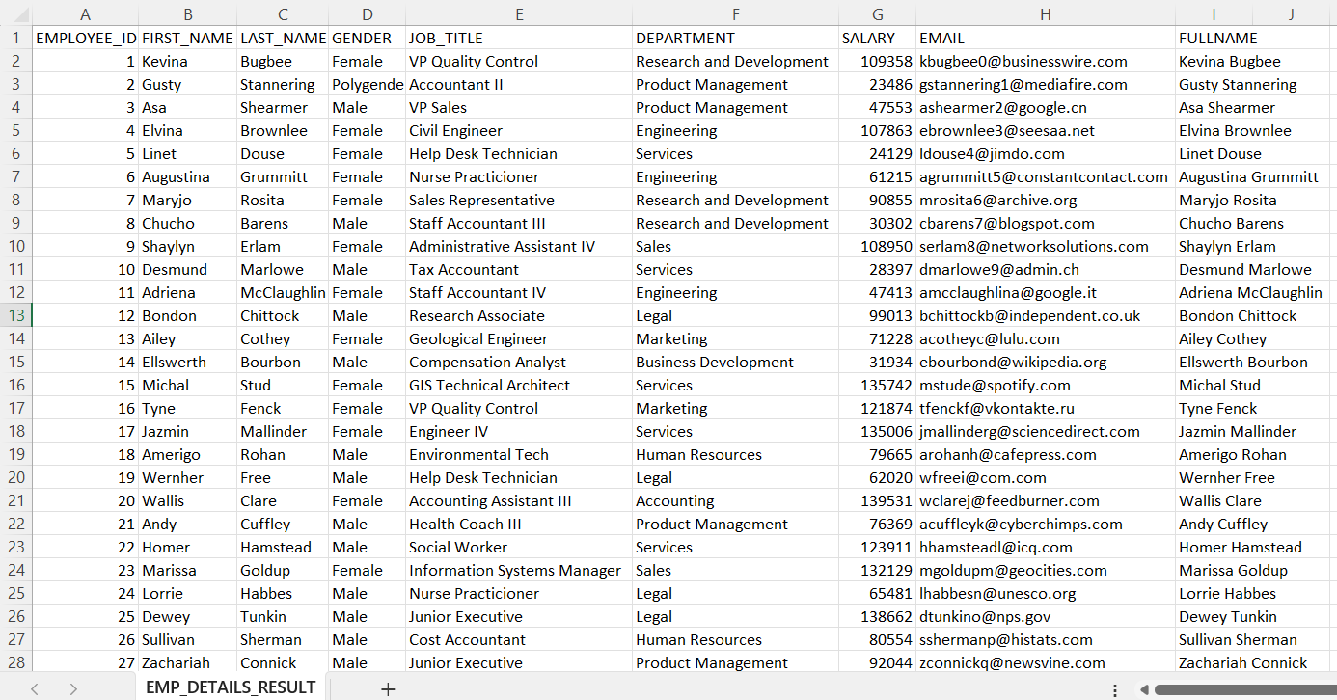
IMPLEMENTATION & CODING ​
- DATA TRANSFORMATION : TERADATA
EMP_DETAILS – Old data.
EMP_DETAILS_RESULT – New data.
Requirement : Add a new column as FULLNAME which will contain the full name of every employee

Slide 12
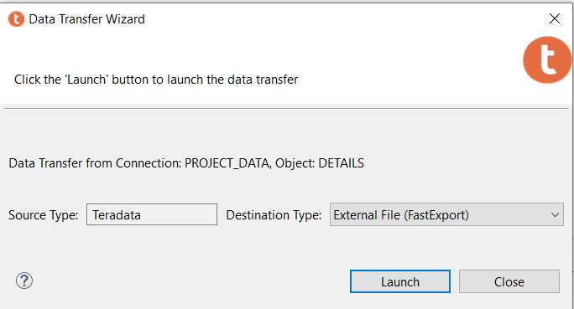
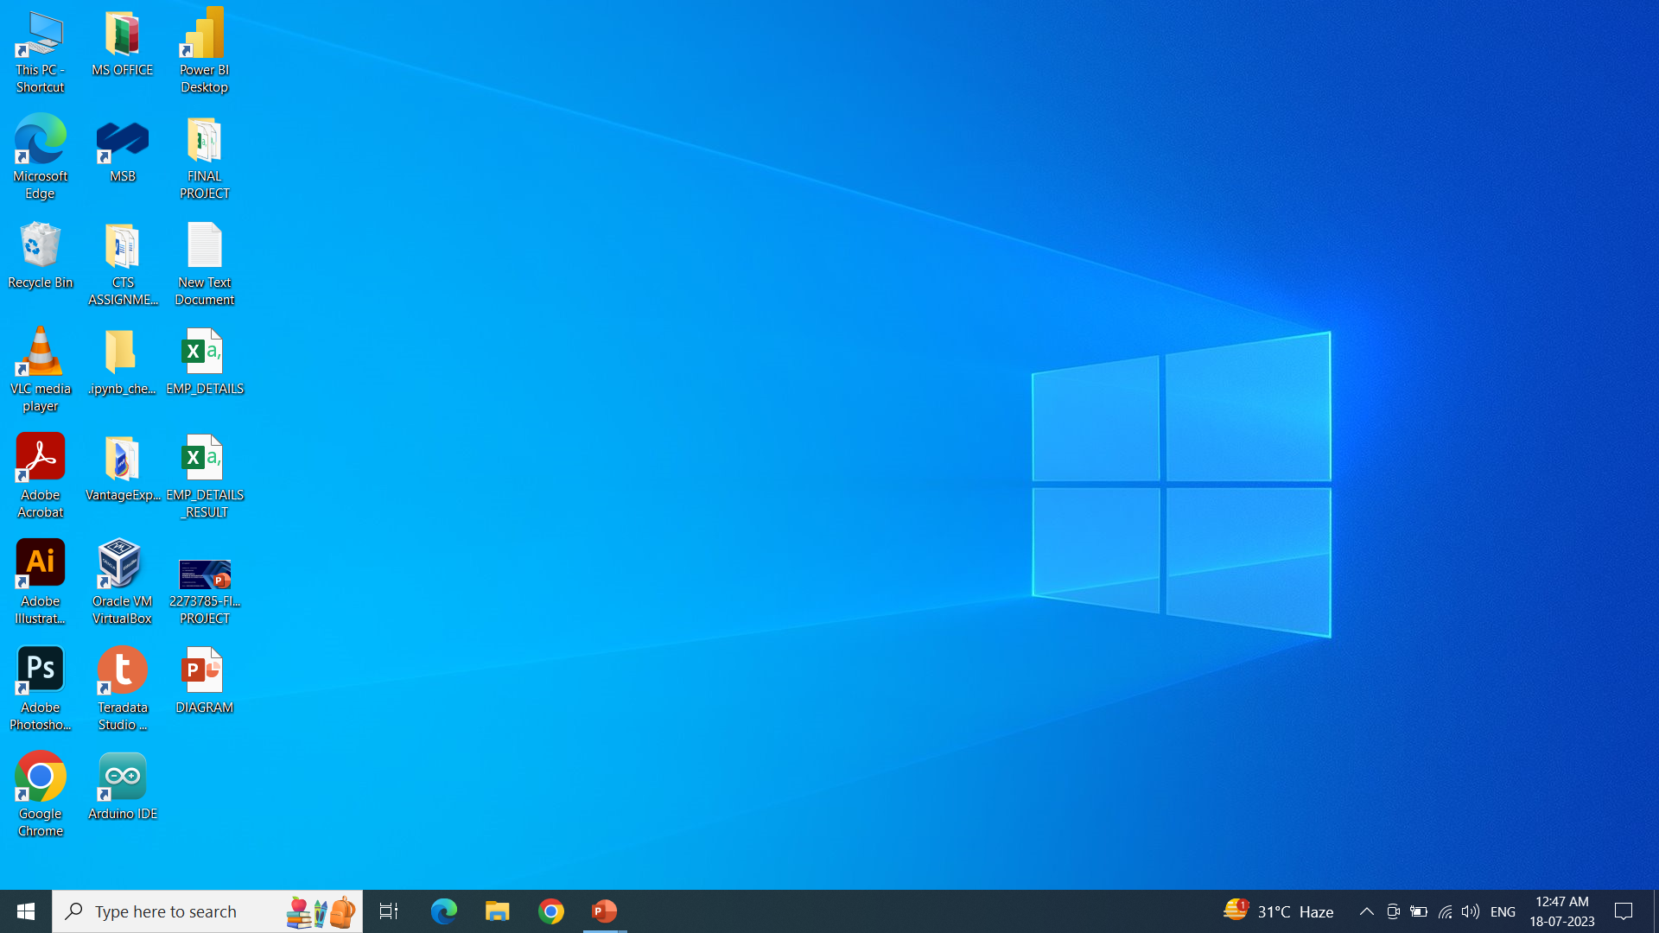
IMPLEMENTATION & CODING ​
- FILE EXPORT : TERADATA
After Updating the Data we FAST EXPORT the Result in CSV Format .
EMP_DETAILS – Loaded Data File.
EMP_DETAILS_RESULT – Exported Data File.

Slide 13
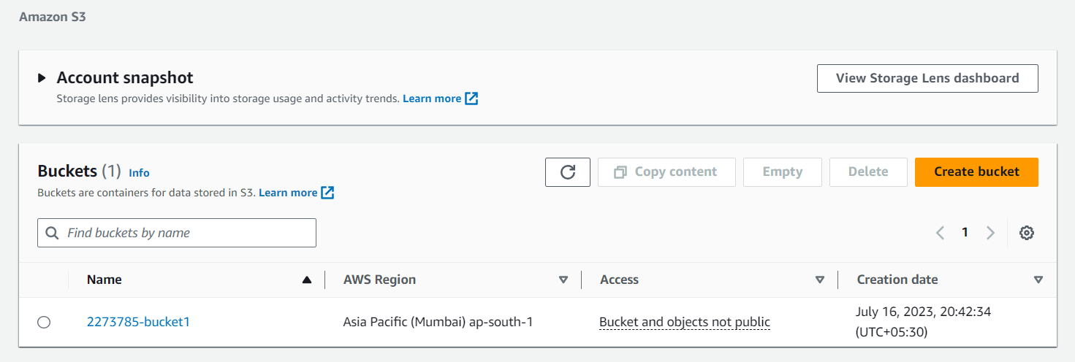
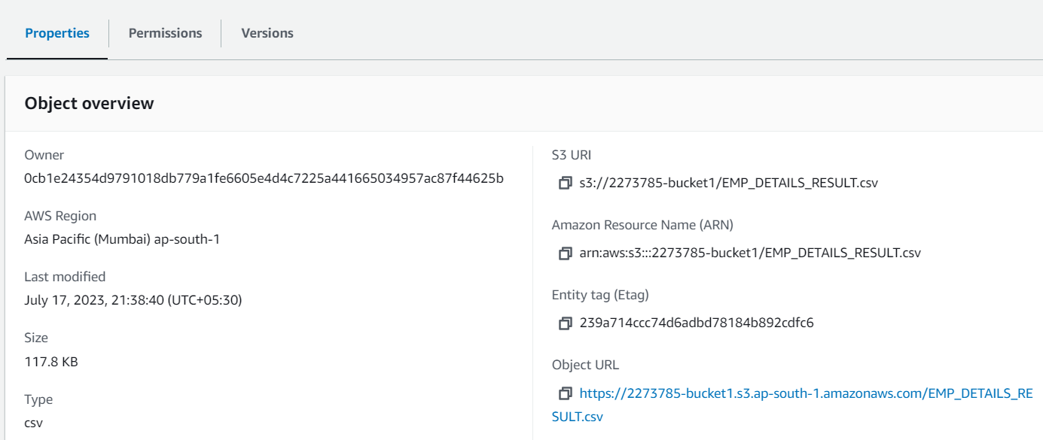
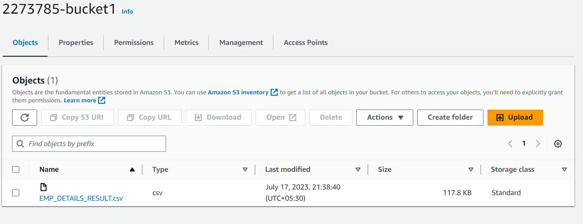
IMPLEMENTATION & CODING ​
- AWS S3 BUCKET CREATION
This URL or Unique Resource Locator is used to locate the file is AWS S3
We stored the Result CSV file exported from Teradata inside the Bucket.

Slide 14
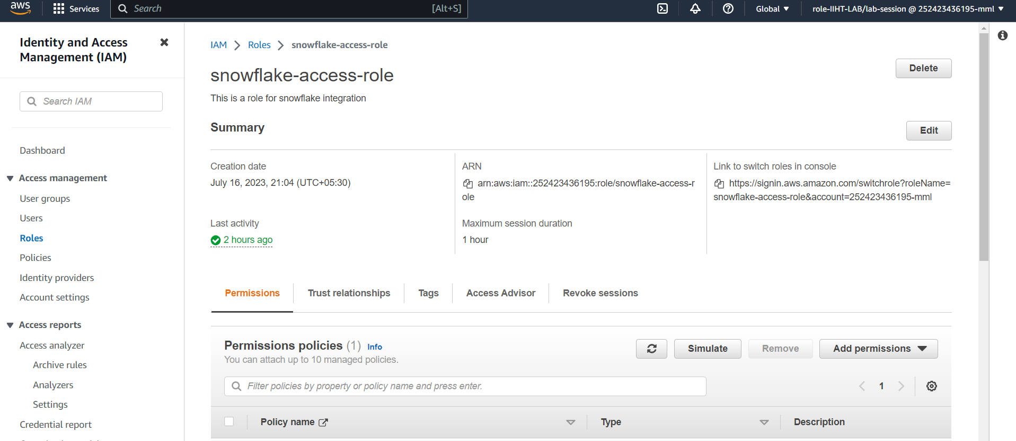
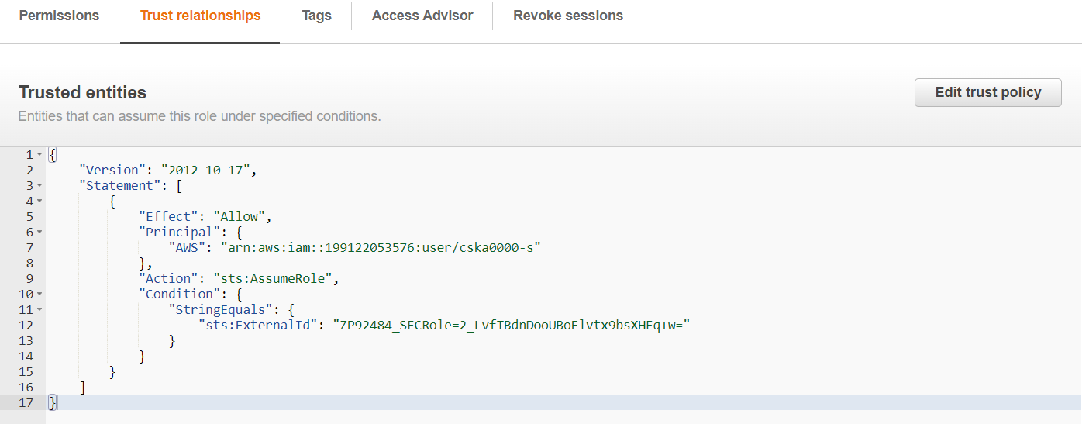
IMPLEMENTATION & CODING ​
- AWS IAM ROLE CREATION
An IAM role is AWS identity with permission policies that determines what the identity can and cannot do in AWS.
Snowflake-access-role is created.
Updating the trust policy to connect it with Snowflake.

Slide 15
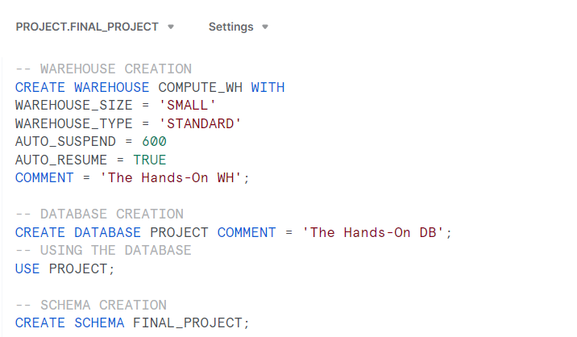
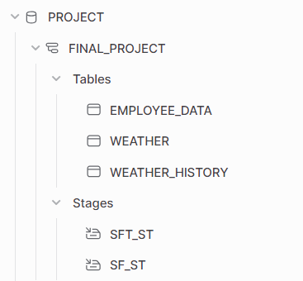
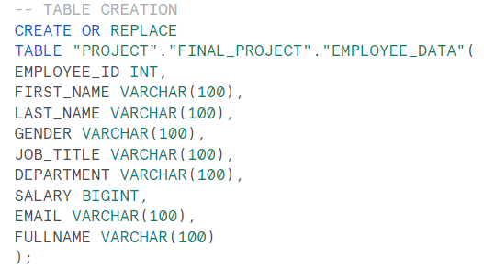
IMPLEMENTATION & CODING ​
- CODING : SNOWFLAKE
Warehouse is Created
Database is Created
Schema is Created
Snowflake Object Hierarchy
Table is Created

Slide 16
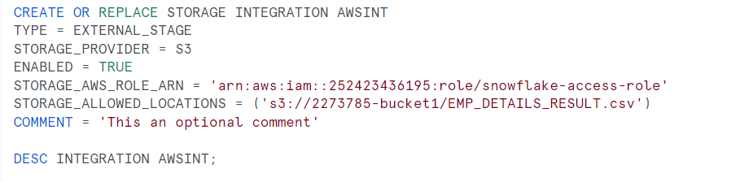
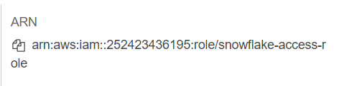
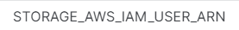
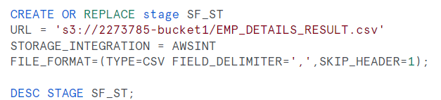
IMPLEMENTATION & CODING ​
- CODING : SNOWFLAKE
The Amazon Resource Name from the Role is used to create the Storage Integration.
We get the STORAGE_AWS_IAM_USER_ARN & External ID by Describing the Storage Integration which are used to connect AWS to Snowflake.
External Stage SF_ST is created.

Slide 17
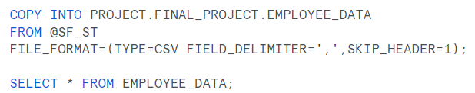
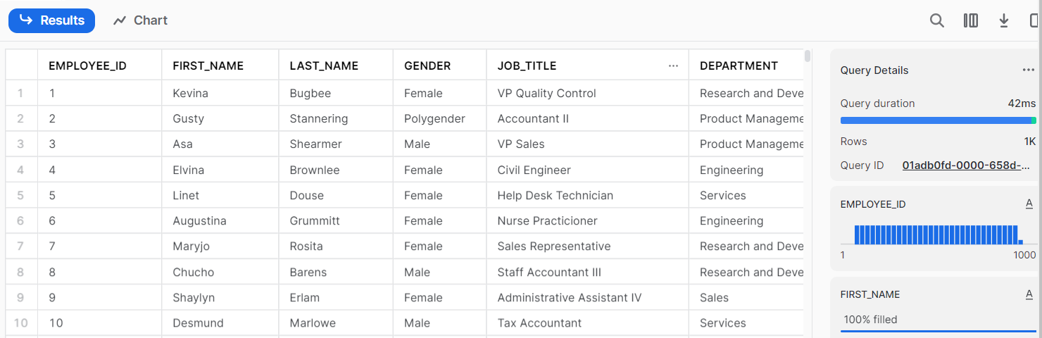
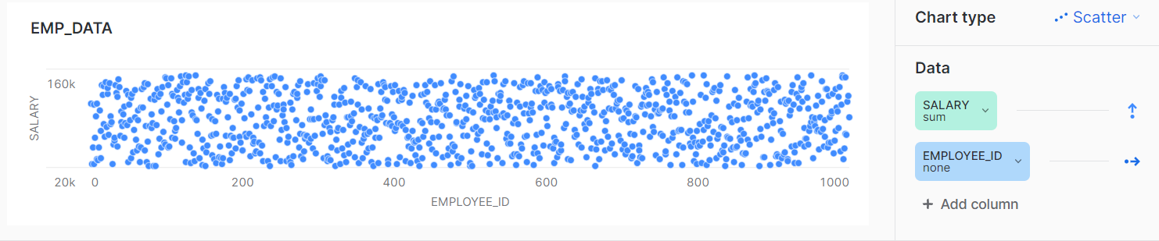
IMPLEMENTATION & CODING ​
- CODING : SNOWFLAKE
We are using COPY INTO command for data loading from the External stage SF_ST.

Slide 18
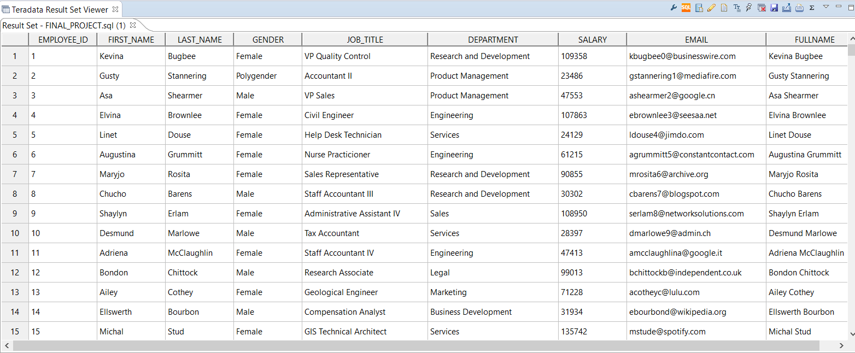
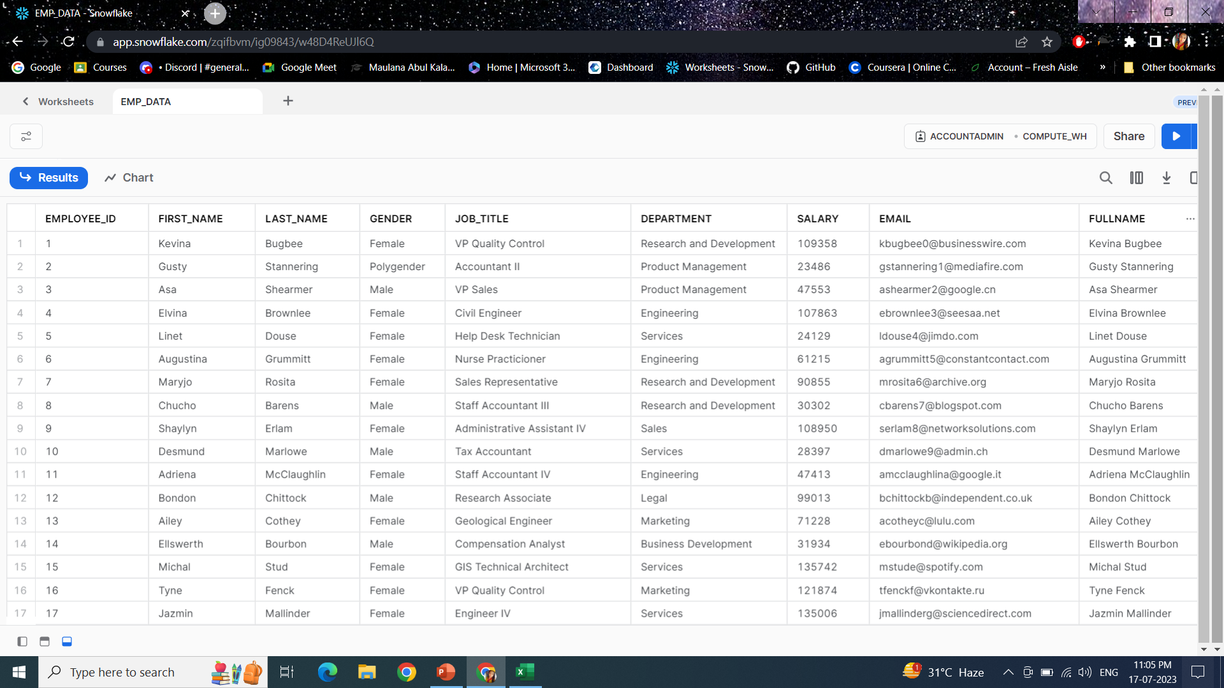
IMPLEMENTATION & CODING ​
- RESULT

Slide 19
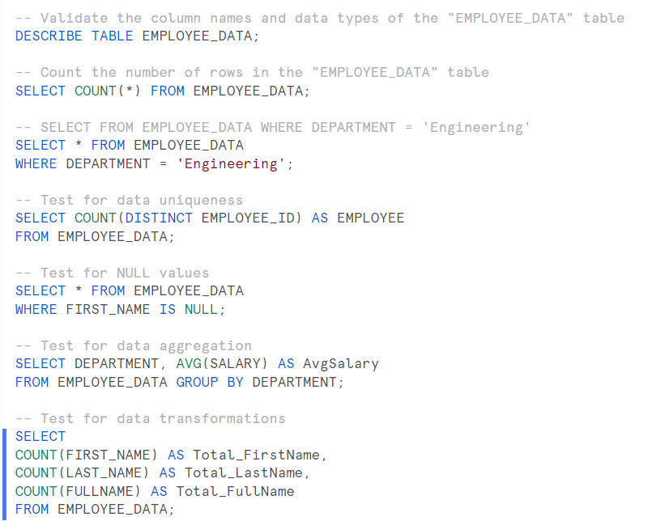
TESTING & VALIDATION​
Firstly, we perform integration testing, by listing the stage SF_ST before loading the data in snowflake.
Then we perform range of testing like:
Testing specific column values.
Checking data uniqueness.
Testing for NULL values.
Performing data aggregation.
Verifying data transformations.

Slide 20

CONCLUSION
Finally, Teradata to Snowflake migration is completed!
By successfully completing this project, we have:
Moved our Data Model from legacy RDBMS like – Teradata to modern Cloud-Native Data Warehouse – Snowflake.
Migrated existing DDL scripts and created new DDL scripts.
Performed data transformation to update the table according to demand.
Loaded Data from Teradata to Cloud Storage like AWS S3.
Connected Snowflake to our Data Source via Storage Integration object Performed scenario based testing jobs to ensure data quality and transformation.
Decommissioned Teradata and provided valuable insights and visualizations to understand and monitor the details of thousand employees.

Slide 21
ACKNOWLEDGEMENT
I would like to express sincere gratitude and appreciation to my Mentor Kavin Kumar Govindaraj for his invaluable guidance and support throughout this project.
I am truly grateful for his insightful feedback, constant encouragement, and mentorship, which have significantly enriched my learning experience.
THANK YOU!

